Slide 1
Data Structures Workshop
Day 5

Slide 2
Workshop Outline
Introduction to Linked Lists
Linked List Class/Node Structure
Inserting Into a Linked List

Slide 3
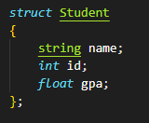
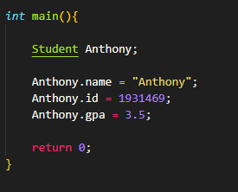
Static Vs. Dynamic Allocation
Suppose we have a list of students, with each student having different information assigned to them which needs to be saved…

Slide 4
Introduction to Linked Lists

Slide 5
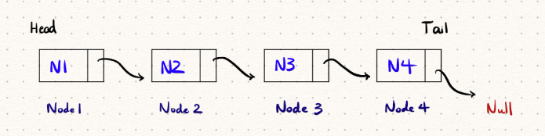
Linked Lists
A linked list is a dynamic, linear data structure used to store data in non-contiguous memory (unlike arrays, which do store data in contiguous memory)
In this class, we’ll be constructing linked lists in a class/struct architecture
- The linked list itself is a class, made up of smaller building blocks, the struct nodes

Slide 6
Why Linked Lists?
We’ve been using arrays so far, but why make a switch to linked lists?
Dynamic Size
- We don’t need to know the size of the linked list to perform any operations on it
- Can keep adding elements to the linked list as needed
Quick Insertion and Deletion
- O(1) time when inserting/deleting at head
- O(1) time when deleting at tail (if tail is given)
Disadvantages
- Takes up more space
- More error prone
- Slow traversal -> O(n) time

Slide 7
Linked List Structure

Slide 8
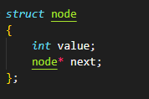
Class/Struct Anatomy of Linked List
A linked list is made up of connected nodes, where each node consists of:
- Data (int, string, char, etc.)
- Address of another node (nodes are linked using pointers!)

Slide 9
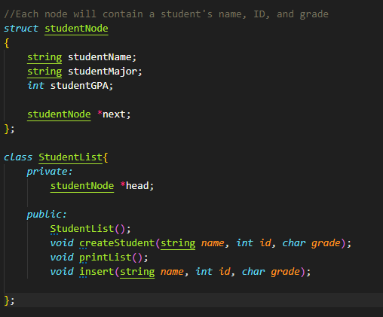
Class/Struct Anatomy of Linked List
Wrapping a Linked List into a class
Private Members:
Head pointer
Tail pointer (optional)
Size (optional)
Public Members:
Constructors/Destructors
Linked List Functions
Insert
Remove
Print

Slide 10
Inserting into a Linked List

Slide 11
Linked List Insertion
We must consider the following when inserting into a linked list:
Inserting when the linked list is empty OR not empty
3 different scenarios when inserting into a linked list:
Inserting at the beginning of it
Inserting at the end of it
Inserting in the middle of it

Slide 12
Linked List Insertion
Check if linked list is empty - is so, set the newly created node as the “head” of the linked list
Otherwise, iterate through the linked list until you reach wherever you want to insert the newly created node (create temp/curr pointer!)
OR until you reach the end of the linked list
Set the new node’s “next” pointer equal to your temp node’s “next” pointer
Set the temp node’s “next” pointer as your new node

Slide 13
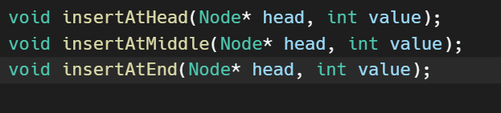
Insertion Practice!
Draw out the following scenarios on a scratch sheet of paper, then write down the code for them on your own (approx. 15 mins):
Insertion at head
Insertion at end
Insertion in middle (assume you’re inserting integers based on order; ascending)
Turn in by end of workshop!

Slide 14
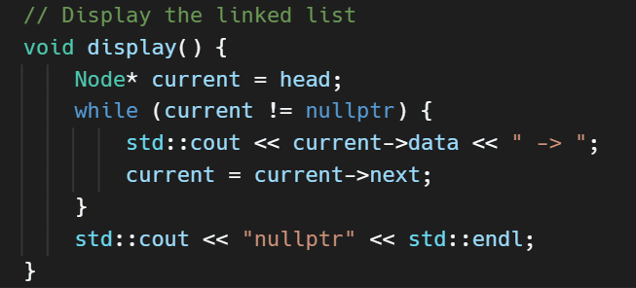
Printing the Linked List

Slide 15
Recursively Print Linked List​
Given a linked list and a node to point towards the head. Recursively print out the linked list​

Slide 16
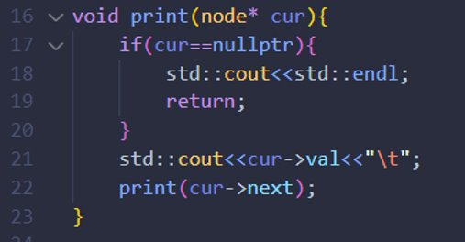
Solution

